Slide 1
Learning Logical Forms for EMR Questions using Recurrent Neural Networks
Anusri Pampari Preethi Raghavan
UIUC IBM Research
AMIA NLP, WG 2017

Slide 2

EMR Question and Answering
Unstructured Clinical Narratives
When was the last colonoscopy?
Radiology report
Why was the patient prescribed arginine?
Discharge Summary
Structured Data
Does the patient have problems
with his gallbladder or gallstones?
History & Physical
Pathology Note
What medications does the patient
take for his dermatomyositis?
Electronic Medical Record
Notes:
EMR capture the physician’s interpretation of the patient’s condition, prognosis, and response to therapeutic intervention. Physicians often need to query this important information that helps them with the clinical decision making process. For example, the physician might want to know when was the last colonoscopy performed or What medication is he on for a particular disease. . In order to enable this, we want to build a system to answer patient specific questions asked by physicians, using the patients EMR record.

Slide 3
Challenges of EMR QA
Understand the meaning of questions
No available datasets
Questions
Intermediate representation
(logical form)
Notes:
The answer is across

Slide 4

Our Contribution
Novel dataset for learning Question-Logical Form-Answer
Use all existing i2b2 challenge datasets
Model learning
Does he have any evidence of MI in EKG?
LabEvent (EKG)[date=x, result=x]
indicates ConditionEvent (MI)
Model
Questions
Logical Forms
Notes:
In our work, we propose a novel method for generating large-scale questions, their logical form and answers by leveraging existing expert annotations on clinical notes which are developed for other NLP tasks like i2b2. We want to make this dataset public to encourage research in this area. We are also working on training a NN based model to do supervised learning on the generated data as training examples.

Slide 5
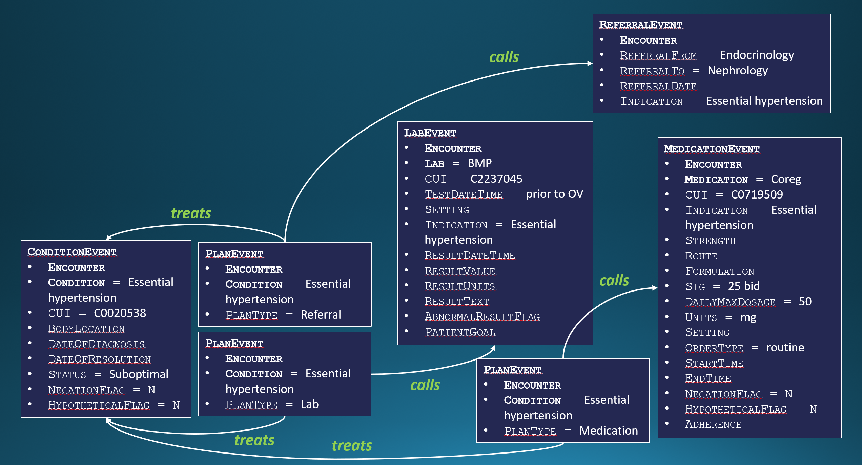
Semantic Frames
Unstructured Clinical Narratives
Radiology report
Discharge Summary
Structured Data
History & Physical
Pathology Note
Semantic Frames
(Structured Data Representation)
Electronic Medical Record
Notes:
A team at IBM is currently trying to achieve this, converting EMR data to a structured format called semantic frames. Semantic frames simply are a set of events inter-related through relations.

Slide 6
Semantic Frames
Represent EMR data using semantic frame representation
(entities, events, relations)
causes
MedicationEvent
Encounter
Medication = “Labetalol”
CUI = C0022860
Indication
Strength
Route
Formulation
Sig
DailyMaxDosage
Setting
OrderType (single admin, prn, routine)
StartTime
EndTime
NegationFlag = N
HypotheticalFlag = Y
Adherence
SymptomEvent
Encounter
Symptom = “Swelling”
CUI = C0038999
BodyLocation
DateOfSymptomOnset
Duration
Frequency
Severity
NegationFlag = N
HypotheticalFlag = Y
15_3778 | NoteID 125 | 2012-07-09 | Nephrology
Review of patient's allergies indicates:
Labetalol Swelling
Electronic Medical Record Note
Semantic Frames
Notes:
For example, the free text in a clinical note such as this, talking about the medication allergy of a patient, “here the patient on using labetalol experiences allergic symptoms of swellings”
can be represented in the semantic frames as a medication event with labetalol as the atrribute and symptom event with swelling as an attribute and these two inter-related through the relation “causes”.

Slide 7
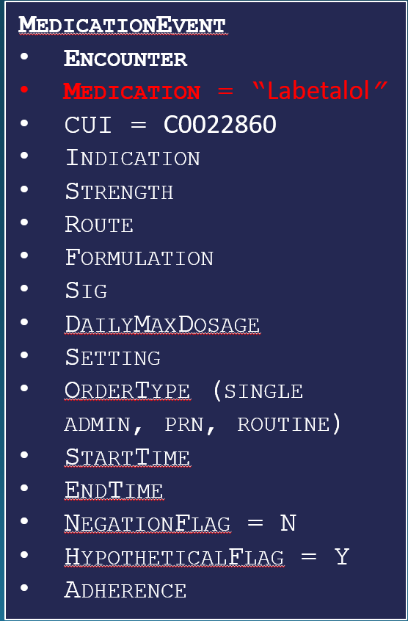
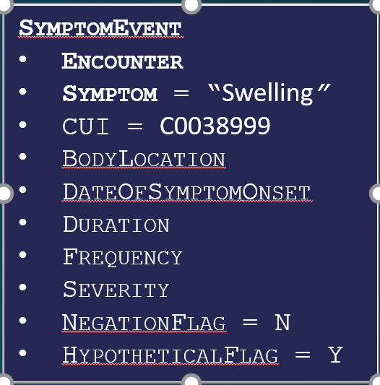



EMR QA System Proposed Pipeline
Does he have any evidence of MI in EKG?
LabEvent (EKG)[date=x, result=x] indicates ConditionEvent (MI)
indicates
Date= Mar 09 2017, result = “yes”
Question
Answer
Semantic Frames
Logical Forms
Semantic Parsing
(Current Focus)
Database Querying
(Future Work)
Notes:
A knowledge based system pipeline on these semantic frames, first converts the question into a structured representation called logical forms. The logical forms are defined such that it makes the answer extraction from the structured data convenient. Here they are defined by the physicians at IBM to extract the events and relations defined in the semantic frames. Using this representation of the question, the system then simply searches the Semantic frames for the answer. For example, here the question “Does he have any evidence of MI in EKG ?” needs to be converted into the logical form “”. Once this conversion is possible the system will understand that it needs to fetch Labevent (EKG) related to condition event(MI) rby the relation “indicates” Once these events in the semantic frames are extracted by the systems, It will look for the date and result fields (marked x) in the lab event to answer the physician's question. These conversion of question to logical forms is called semantic parsing and using logical forms to answer the questions is Database querying. The focus of my current work and the opic of the presentation is to do semantic parsing. In the future we would like to do the database querying in order have an end to end EMR QA system.

Slide 8
Semantic Parsing Models
Not scalable
Rule Based
Supervised large existing Question-Logical from datasets Geo Query, Jobs, ATIS Robin et al by Stanford
Weak Supervised Factoid QA: crowdsource to get QA pairs SEMPRE by Stanford
Unsupervised Factoid QA: biomedical corpus to build knowledge base Poon et al
No large labeled datasets
Physician generated manual annotations of 446 questions-logical forms
Roberts et al
Non factoid QA
EMR free text lacks grammar

Slide 9
Dataset Generation

Slide 10
I2b2 Dataset
Existing Annotated NLP Datasets | Using Annotations/Context
2006 Deidentification and Smoking Challenge | context
2008 Obesity Challenge | context
2009 Medication Challenge | medications, their dosages, modes, frequencies, durations, and reasons
2010 Relations Challenge | Medical problem, their treatments and tests
2011 Coreference Challenge | Problem, tests, treatment
2012 Temporal Relations Challenge | Time relations between problem, test and treatment
2014 Heart Disease Risk Identification Challenge | Vital, test and treatment indicators of diabetes, CAD, Hyperlipidemia and hypertension
Notes:
The i2b2 dataset, has annotations introduced as a part of the following challenges. The medication challenge for example has annotation of “” and the relations challenge has annotations has annotations of problem, treatments and their tests. We make use of all the annotations from these challeges to develop large scale questions-logical forms dataset. We do so by following the given procedure:

Slide 11
Dataset Generation Process
I2b2 annotation template
EMR
I2b2 annotation value
Apply the question – logical form templates
to generate questions using the available i2b2 annotation value
Develop a set of question- logical form templates
for each available annotation template
Notes:
Overview of goin from annotation to value

Slide 12
Relations Challenge Dataset
|Test| reveals |problem|
EMR
EKG reveals MI
I2b2 annotation template
I2b2 annotation value
Q: Does he have any evidence of
MI in EKG ?
L: LabEvent (EKG) [date = x , result = x] indicates
ConditionEvent (MI)
A: date = 11|01|2017, result = yes
Q: Does he have any evidence of |problem| in |test|?
L: LabEvent (|test|) [date = x , result = x] indicates
ConditionEvent (|problem|)
Develop a set of question- logical form templates
for each available annotation template
Apply the question – logical form templates
to generate questions using the available i2b2 annotation value

Slide 13
Relations Challenge Dataset
|Test| reveals |problem|
EMR
perfusion scans reveals CAD
I2b2 annotation template
I2b2 annotation value
Q: Does he have any evidence of
CAD in perfusion scans ?
L: LabEvent (CAD) [date = x , result = x] indicates
ConditionEvent (perfusion scans)
A: date = 11|02|2017, result = yes
Q: Does he have any evidence of |problem| in |test|?
L: LabEvent (|test|) [date = x , result = x] indicates
ConditionEvent (|problem|)
Develop a set of question- logical form templates
for each available annotation template
Apply the question – logical form templates
to generate questions using the available i2b2 annotation value

Slide 14
Medications Challenge Dataset
nitroglycerin 1/150 ( 0.4 mg ), 1 tab, sl,q5min x 3 prn,nm, chest pain, list
medication, dosage, mode, frequencies, duration, reasons, list/narrative
EMR
I2b2 annotation template
I2b2 annotation value
Q: What is the dosage of |medication| ?
L: MedicationEvent (|medication|) [Dosage=x]
Q: What is the dosage of nitroglycerin 1/150 ( 0.4 mg) ?
L: MedicationEvent (nitroglycerin 1/150 ( 0.4 mg) ) [Dosage=x]
A: Dosage = 1 tab
Q: Why was the patient prescribed |medication| ?
L: MedicationEvent (|medication|) treats
ConditionEvent (x)
Q: Why was the patient prescribed nitroglycerin 1/150 ( 0.4 mg) ?
L: MedicationEvent (nitroglycerin 1/150 ( 0.4 mg) ) treats
ConditionEvent (x)
A: chest pain
Develop a set of question- logical form templates
for each available annotation template
Apply the question – logical form templates
to generate questions using the available i2b2 annotation value

Slide 15
Dataset Analysis
Total logical form templates = 44
Indicates the range of answer concepts covered in the dataset
Total question templates = 105
Multiple question can map to a single logical form
Some of these questions are simple syntactic variations
Total number of questions and logical forms generated form the templates = 542,749
Notes:
By following this process across all the i2b2 challenges, we developed a total of 44 logical form templates. This number is indicative of the range of answer concepts covered in the dataset, like date, result, problem, test. The total number question templates generated is, this number is greater than the logical form templates because multiple questions can map to a single logical form. Some of the questions were introduced to ensure syntactic variability in questions, because questions can be phrased differently by physicians. BY using these templates, and using the i2b2 template values to fill these templates we generated a total of K questions and logical forms.

Slide 16
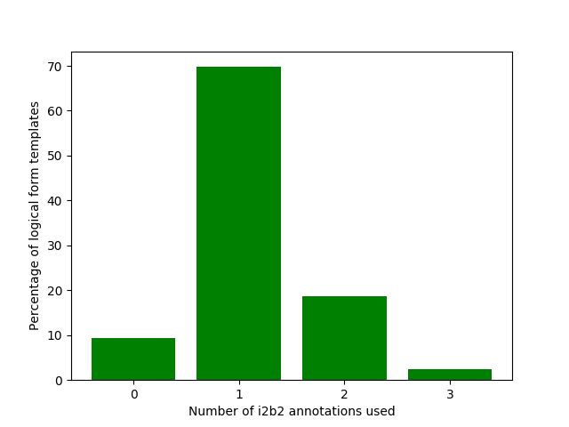
Dataset Complexity Analysis
Distribution of number of i2b2 annotations used in question-logical form templates
9% No annotation used
Any changes in medication ?
70% One i2b2 annotations used
What is the dosage of |medication| ?
20% Two i2b2 annotations used
Does he have any evidence of
|problem| in |test|?
1% Three i2b2 annotations used
Is the patient taking any
|mode| |medication| for |problem| ?
Notes:
Characteristics of dataset Relations, concepts, group templates, question length, number of concepts in each question Number of questions in each template. Template wise classification and qclassfication
Sufficiently general question dataset is the idea. Keeping in mind lack . More templates to make to more general. Question paraphrasing

Slide 17
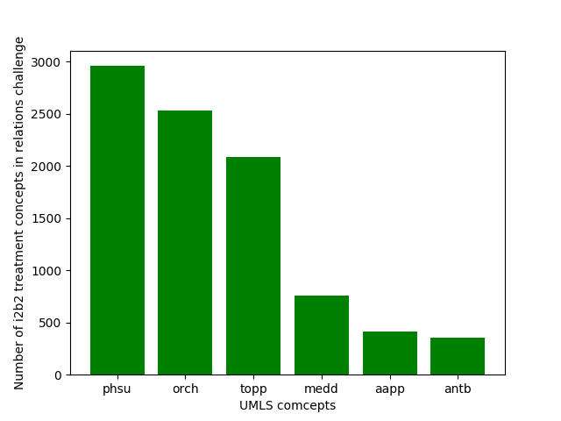
Dataset Complexity Analysis
Evaluate complexity of logical forms (events in semantic frames)
Qualitative estimate, distribution of i2b2 concepts with UMLS
70 % of i2b2 “treatment” concepts in 6 UMLS Semantic types*
Pharmacologic Substance
Organic Chemical
Therapeutic or Preventive Procedure
Medical Device
Amino Acid, Peptide, or Protein
Antibiotic
(only relations challenge)
Notes:
Put in back problem and test,

Slide 18
Ongoing Evaluation
Mapping of i2b2 concepts with UMLS concepts
Estimation of noise in the annotations
Distribution of question length
Distribution of questions generated per template

Slide 19
Dataset Evaluation
To evaluate coverage, compare our dataset to 4240 medical expert generated question
60.14 % of the questions match our dataset
31.15 % of the questions maybe included
8.7 % of question are not included in our dataset
Questions not a part of the dataset | Annotations needed to generate these questions
When was the last X-ray taken on her osteoarthritic joint ? | Test and body location
Has the patient received a year flu shot ? | Vaccination Concepts
Notes:
We are evaluating our dataset by its coverage on a dataset of 5000 physician generate questions. Add question variants. General features.

Slide 20
Error Analysis
Noisy i2b2 annotations
Classified into 9 classes of errors
Use UMLS CUI and POS tags
I2b2 noise type | Dataset | Noisy i2b2 Annotation Example | Question Template
Annotations with additional unnecessary information | Medication Challenge | February of this year, when the sulfonylurea was replaced with insulin | What is the dosage of |medication| ?

Slide 21
Ongoing Work
Remove noise in the data per error class
Increase syntactic variations in the questions
Make the data opensource

Slide 22
Model Learning
Notes:
Ongoing work on errors. We plan to realize dataset

Slide 23
Our Contribution
Novel Dataset for Question-Logical Form-Answer
Use all existing i2b2 challenge datasets
Model Learning
Does he have any evidence of MI in EKG?
LabEvent (EKG)[date=x, result=x]
indicates ConditionEvent (MI)
Model
Questions
Logical Forms
Notes:
In our work, we propose a novel method for generating large-scale questions, their logical form and answers by leveraging existing expert annotations on clinical notes which are developed for other NLP tasks like i2b2. We want to make this dataset public to encourage research in this area. We are also working on training a NN based model to do supervised learning on the generated data as training examples.

Slide 24
Model Learning
Use generated dataset to train a model
Questions: human language
Logical Forms: Machine language
Notes:
Now that we have generated question-logical form dataset. We can now train a supervised model using the generated data as training data. The input questions and output logical forms can be seen as representation of language, questions are representation of human language and logical forms are representation of structured language used by machine.

Slide 25
Proposed Pipeline
Does he have any evidence of MI in EKG?
Attention Based Encoder-Decoder Architecture
RNN
Model
LabEvent (EKG)[date=x, result=x]
indicates ConditionEvent (MI)
Questions: human language
Language Translator
Logical Forms: Machine language
Notes:
So modeling a semantic parser can be seen as modeling a language translator. One such supervised training techniques used by modern translators to translate from one language to another like from English to Chinese etc are Attention Based Encoder decoder RNN architecture. We use the generated data for training this model. Here the model is trained to predict the logical form as output given input as a question.

Slide 26

Model Evaluation
Training Data: 80 % , Test Data: 20%
Accuracy = $\frac{Total question−logical forms correctly predicted}{Total question−logical forms test cases}$
Trained on only 3 i2b2 challenges (medications, relation, heart disease risk)
Accuracy = 40%

Slide 27
Advanced Model
Attention based Encoder-Decoder Architecture with copy
Accuracy 80%
Does he have any evidence of MI in EKG?
Question Splitting
Model
LabEvent (EKG)[date=x, result=x]
indicates ConditionEvent (MI)
Advanced Model
Notes:
To reduce concept mismatch errors we use an advanced model, Attention based encoder decoder architecture with copy which has the additional mechanism where it can copy concepts from the input question.

Slide 28
Error Analysis
Notes:
After using theadvanced model the concept errors reduced 7% from th2 28% seen earlier. We will further use the advanced model on the entire dataset of ()K and evaluate the performance.

Slide 29
Ongoing Work
Evaluate the model on the entire training data
Try advanced features (using UMLS)
Automate question splitting
Build an end to end QA system

Slide 30
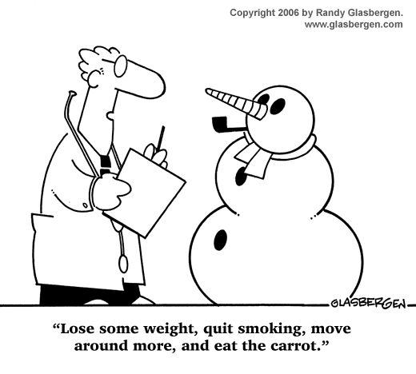
Lifestyle changes?
Smoking Event (x)
AND
Diet Event (x)
AND
Weight Event (x)
Thank you ! ☺

Slide 31
Supplementary Slides

Slide 32
Semantic Frames
evaluates
15_3778 | NoteID 163 | 2013-07-17 | Endocrinology
ASSESSMENT/PLAN:
1. 250.0 DM w/o complication type II, controlled
Worsened control, had decreased his U-500 insulin dose to 0.15 ml bid bc of hypoglycemia. A1C increased to 7.8%.
LabEvent
Encounter
Lab = A1C
CUI = C4291676
TestDateTime
Setting
Indication
ResultDateTime
ResultValue = 7.8
ResultUnits = %
ResultText
AbnormalResultFlag = Y
PatientGoal
ConditionEvent
Encounter
Condition = DM w/o complication type II
CUI = C0011860
BodyLocation
DateOfDiagnosis
DateOfResolution
Status = Worsened control
Electronic Medical Record Note
Semantic Frames
Notes:
Let us look at another example, this clinical note talks about how the condition event, “DM w/o complication type 2” has been evaluated using lab test A1C. This note can be represented in structured format by defining a lab event and a condition event inter-related by the relation “evaluates’.

Slide 33
Data Analysis

Slide 34
Model Anlaysis

Slide 35
Error Analysis
Concept Mismatch Errors
Length Mismatch Errors
Logical Form Mismatch Errors
Bracket Errors
Notes:
To understand the poor performance of the model, we did some error analysis and identified four kinds of errors. We will look at this errors one by one.

Slide 36
Concept Mismatch Errors
Question: what life style changes impacted MI ?
Ground truth: smoking event (x) impacts (MI) and diet event (x) impacts (MI) and weight loss event (x) impacts (MI)
Model output: smoking event (x) impacts (arthritis) and diet event (x) impacts (arthritis) and weight loss event (x) impacts (arthritis)
Notes:
The model made concept mismatch errors, where it predicted the wrong concept. For example, consider the question and its corresponding logical form. Instead of predicting MI in the logical form the model predicted the concept arthritis instead. This error largely occurred when the model sees a new concept in the test data which it has not seen during training.

Slide 37
Length Mismatch Errors
Question: what life style changes impacted MI ?
Ground truth: smoking event (x) impacts (MI) and diet event (x) impacts (MI) and weight loss event (x) impacts (MI)
Model output: smoking event (x) impacts (arthritis)
Notes:
The model made Length mismatch errors, where it could not predict the entire logical form. This was prevalent with questions which had really long logical forms.

Slide 38
Logical Form Mismatch Errors
Question: what life style changes impacted MI ?
Ground truth: smoking event (x) impacts (MI) and diet event (x) impacts (MI) and weight loss event (x) impacts (MI)
Model output: smoking event (x) treats (MI) and diet event (x) impacts (MI) and weight loss event (x) impacts (MI)
Notes:
The logical form mismatch errors are where the model predicted the wrong logical form, here the model preducts treats instead of impacts. Other examples are where it predicted the wrong event , like predicting condition event instead of lab event

Slide 39
Bracket Errors
Question: what life style changes impacted MI ?
Ground truth: smoking event (x) impacts (MI) and diet event (x) impacts (MI) and weight loss event (x) impacts (MI)
Model output: smoking event (x) impacts (MI) and diet event (x) impacts (MI) and weight loss event (x) impacts (MI)
Notes:
Bracket errors are small errors where the model opened a bracket but forgot to close it.

Slide 40
Error Analysis
concept mismatch and length mismatch errors are dominant
Notes:
This is the distribution of errors. 34% of the logical forms were wrong because of concept mismatch errors, 18% are wrong because of length mismatch errors, 6% because of logical form mismatch errors and 2% were bracket errors.

Slide 41
Proposed Pipeline
Question-Logical forms splitting to reduce length Mismatch Errors
Does he have any evidence of MI in EKG?
Attention Based Encoder-Decoder Architecture
Model
LabEvent (EKG)[date=x, result=x]
indicates ConditionEvent (MI)
Question Splitting
Model
Notes:
On order to reduce the length mismatch errors, that is errors caused because of long logical forms, we propose to introduce a question spliiting model before our RRn model. The question splitting model splits the questions with long logical forms into sub questions such that eash sub question as a small logical form.

Slide 42
Results
Method 1: w/o question splitting
Question: what life style changes impacted MI ?
Logical Form: Smoking Event (x) impacts (MI) AND Diet Event (x) impacts (MI) AND Weight Loss Event (x) impacts (MI)
Notes:
For example, when question splitting was not considered the model was trained on this entire question and logical form. This logical form was not predicted completely by the model because of the long logical form.

Slide 43
Results
Q: what life style changes impacted MI ?
With question splitting
Question 1: Does smoking impact MI ?
Logical Form 1: Smoking Event (x) impacts (MI)
Question 2: Does diet impact MI ?
Logical Form 2: Diet Event (x) impacts (MI)
Question 3: Does weight loss impact MI ?
Logical Form 2: Weight Loss Event (x) impacts (MI)
Notes:
Considering question splitting implies the model will only need to be trained on the sub questions. Instead of training on the single question and the long logical form, we train the model on these sub questions and short logical forms of these sub questions. For now inorder to evaluate the model performance we do the question splitting manually and train and test the model directly on the sub questions and short logical forms. On doing this we imporved the accuracy of the model to 65%. In the future we hope to automate this process by building a model which can automate the splitting process.

Slide 44
Error Analysis
Concept Mismatch Errors are dominant
Notes:
On training the model on the sub questions with short logical froms the length mismatch errors reduced significantly to 3%. Now the dominant errors are caused due to concept mismatch errors.

Slide 45
Concept Mismatch Errors
Question: what life style changes impacted MI ?
Ground truth: smoking event (x) impacts (MI) and diet event (x) impacts (MI) and weight loss event (x) impacts (MI)
Model output: smoking event (x) impacts (arthritis) and diet event (x) impacts (arthritis) and weight loss event (x) impacts (arthritis)
Notes:
Concept mismatch errors are caused because the model does not have a mechanism to recognize that the concept in the logical form needs to be copied from the question itself instead of trying to predict on its own. By introducing this mechanism we can alleviate this error

Slide 46
Results
Method 1: w/o question splitting
Method 2: with question splitting
Method 3: Advanced Model
Attention based encoder-decoder architecture with copy
Notes:
By using this advanced mechanism, attention based encoder-decoder RNN architecture with copy the accuracy improved to 80%.

Slide 47

QA System Pipeline
Unstructured Clinical Narratives
Questions asked by physicians
Radiology report
Analyze and Understand the Question
Discharge Summary
Structured Data
History & Physical
Extract Answer and Relevant Context
EMR
Pathology Note
Display Answer
Notes:
A typical QA pipelines starts with understanding the question. Once the system understands the meaning or intent of the question, it can now extract the answer from the EMR record.

Slide 48
QA System Pipeline
Two paradigms of Q&A systems
Information Retrieval based
Knowledge-based
Structured data retrieval
EMR (structured + unstructured) data → Semantic Frames (structured data)
Notes:
There are two ways in which QA pipelines are implemented. 1) Information Retrival Based and 2) Knowledge Based. Information retrieval systems generally return results only at a coarse level,like our search engines and since the physicians have a minimal amount of time to search for answers – often as little as two minutes, we will look at knowledge based system pipelines,
For increased speed. The reason behind the speed advantage of these knowledge based systems is that the data to be retrieved is represented in structured form. The EMR data typically is combination of both structured and unstructured data. Structured data includes fields for medications etc and unstructured data includes clinical notes written as free text. In order to use a knowledge based retrieval system we want to convert this combination of structured and unstructured data of EMRs to only structured data.

Slide 49
Semantic Frames
Unstructured Clinical Narratives
Radiology report
Discharge Summary
Structured Data
History & Physical
Pathology Note
Semantic Frames
(Structured Data Representation)
Electronic Medical Record
Notes:
Hence on the whole, the entire EMR record of a patient can be defined in terms of set of events and relations called semantic frames. Now assuming this is in place, we can now build a knowledge based QA system to answer physician question on EMRs.

Slide 50
References
Roberts, Kirk, and Dina Demner-Fushman. "Toward a Natural Language Interface for EHR Questions." AMIA Summits on Translational Science Proceedings 2015 (2015): 157.
Gu, Jiatao, et al. "Incorporating copying mechanism in sequence-to-sequence learning." arXiv preprint arXiv:1603.06393 (2016)

